Slide 1


PENINSULA TECH CLUB
GIFT LIST 2020

Slide 2
PTC GIFT LIST 2020
Brought to you by the TECH CLUB …
      Barry Stiefel
      Susan Bies
      Diep Lavu
      Mike Palmer
      Jay Richman

Slide 3
PTC GIFT LIST 2020
THE CATEGORIES …
Gifts that we HAVE and love
Gifts that we DON’T HAVE but want
Gifts UNDER $25
Gifts $50 - $200
Gifts for the GRANDKIDS
Gifts where money is NO OBJECT

Slide 4
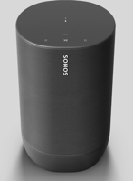
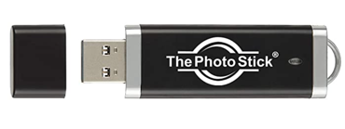
Gifts that we have and love
SONOS MOVE SPEAKER - portable and waterproof. Connects through wifi network but also can connect through Bluetooth to another device. SONOS IS OFFERING A $100 DISCOUNT! … $399 to $299
The Photo Stick– great for backing up all your photos, videos. It is just plug in and go. Comes in 8/64/128 GB. Just buy the 128GB you will need it!! Amazon $54

Slide 5
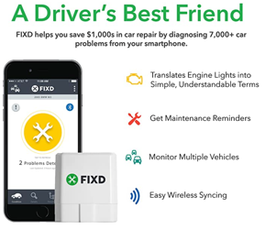
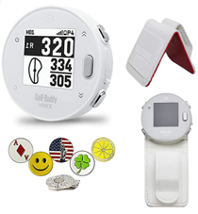
Gifts that we have and love
FIXD - Check Engine Light Diagnostics — Read and diagnose your check engine light, understand the severity of the issue, and clear that pesky light from your vehicle. plugs into your car [all gas powered cars after 1996 have the port] somewhere near steering wheel. Amazon $60
GolfBuddy Voice X GPS/Rangefinder Bundle with Belt Clip, 5 Ball Markers and 1 Magnetic Hat Clip, Amazon $90

Slide 6
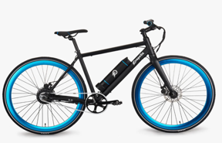
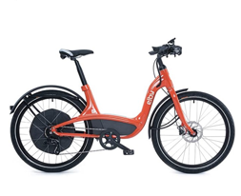

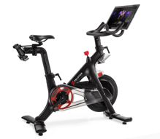
Gifts we DON’T HAVE but WANT
PROPELLA 7-SPEED E-BIKE (V3.4)
$1,500
ELBY Bike – 9 Speed Electric Bike, pedal or glide, 80 miles on single charge, up to 20 MPH Amazon $2,880
Peleton Bike - convenient & immersive indoor cycling experience, streaming daily live classes with 24-hour access to studio cycling classes. $1,895 plus $39 monthly subscription

Slide 7
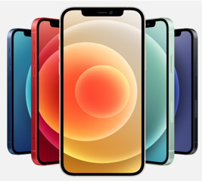
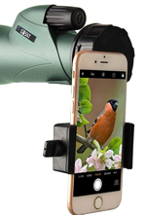
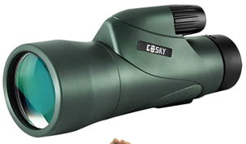
Gifts we DON’T HAVE but WANT
IPHONE 12 - 5G speed. A14 Bionic, the fastest chip in a smartphone. An edge-to-edge OLED display. Ceramic Shield with 4x better drop performance. Night mode on camera. Prices range from $599 to $1,499 based on size of phone & memory. Three different sizes. Pro Max is biggest with 6.7”, the 12 Pro and 12 both are 6.1” and the mini is 5.4” Storage is from 64GB to 256. Up to 512GB on the Pro and Pro Max. Compared to the iPhone10 the 12 is a little bigger but it is not a huge difference. Take note there are some service ”dropping” issues in some areas.
Gosky 12x55 High Definition Monocular Telescope and Quick Smartphone Holder, Amazon $106

Slide 8
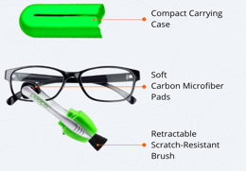
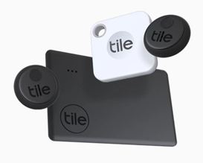
Gifts UNDER $25
PEEPS- The 2020 way of cleaning glasses, uses a revolutionary & patented invisible carbon formula to safely/easily clean glasses. $20
TILE- lost & found tracker, attaches to most anything. $25

Slide 9
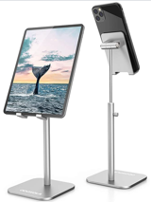

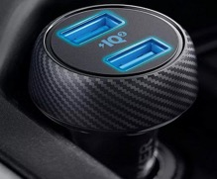
Gifts UNDER $25
Cell Phone Stand, an ergonomic solution Amazon $12
Clip Reading Light, great for zoom calls! Amazon $20
Anker 30W Dual USB Car Charger - PowerDrive Speed 2 with PowerIQ 2.0 for Galaxy S8/Edge/Note, iPhone Xs/Max/XR/X/8, iPad Pro/Air 2/Mini, and More. Dual ports pump out 30W total—enough for both driver and passenger to access high-speed charging. Amazon $18. Pro tip: Check out the many products ANKER has on-line [www.anker.com] … adapters, chargers, hubs, USB, power strips, etc.

Slide 10
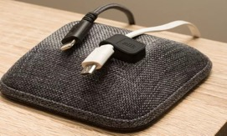
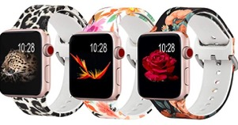
Gifts UNDER $25
Silk Magnetic Cable Wrangler – an attractive solution, it neatly hold cables on desk or nightstand, Compact & stable, works with all cables and chargers. Amazon $20
Apple Watch floral replacement bands – Koreda Floral Bands Compatible with Apple Watch 38mm 40mm, Silicone Fadeless Pattern Printed Replacement Bands for iWatch SE & Series 6 & Series 5/4/3/2/1 for Women Men
Pack of 3, Amazon $14. Pro tip: check to make sure you have the models listed.

Slide 11

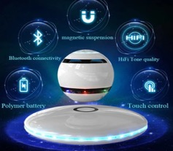
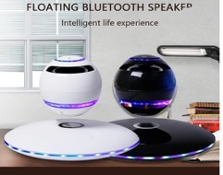
Gifts $50 - $200
MOBILE KLEAN ultra light sanitizer – UV light pathogen killer. Simply “swipe away pathogens with light” and sanitize all your precious devices, good for all sorts of surfaces within the home (laptop keyboards and smartphones, cutlery, even toilets). Www.mobilekleanstore.com for $50. Amazon has a Sharper Image UV sanitizing wand for $40
Magnetic Levitating Bluetooth Speaker – 3D sound effect, projects different color when activated, can be used as a stand-alone speaker without a base and the base illuminates continuously different color LED lights, can easily be connected to all Bluetooth-enabled devices within 10 meters. Amazon Infinity Orb magnetic levitating speaker $88

Slide 12
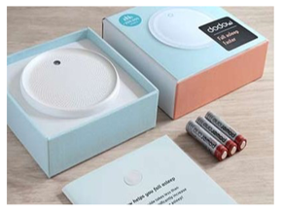
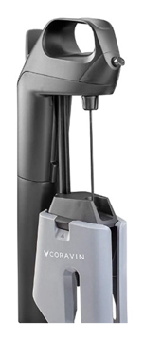
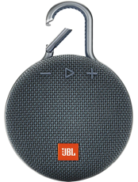
Gifts $50 - $200
Dodow - metronome light, scientifically designed to block out overactive thought patterns and lull you into a deep peaceful sleep – fast. Expensive for one $59/ $44.50 if you buy two.
CORAVIN - Model Three advanced wine bottle opener and preservation system, Amazon $200
JBL CLIP 3 - Waterproof Portable Bluetooth Speaker, Amazon $40. Pro tip: comes in lots of colors, also buy a carrying case, great for golf!

Slide 13
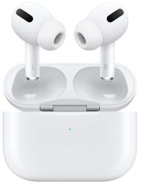
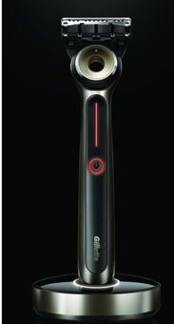
Gifts $50 - $200
APPLE AIRPODS - Pro version of the Apple AirPods. Improved charging (charge case/10 uses before recharge). Next level sound, noise cancelation for privacy, a unique transparency mode that lets you listen but also lets some outside sound in when you want to be able to listen but hear what’s going on around you. $250 (regular airpods approx $120)
HEATED RAZOR BY GILLETTE LABS - designed by Gillette Labs, the engineering is really what makes this great. This razor comes very close to replicating a hot towel barbershop shave. $140

Slide 14
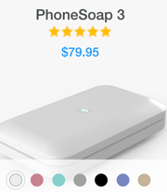
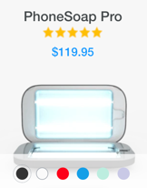
Gifts $50 - $200
=
PhoneSoap - a UV Sanitizing device that specializes in UV-C for smartphones, it cleans your phone while it charges. It kills 99.9% of bacteria in 5 minutes . PhoneSoap 3 is $79.95 (7 colors) and the PhoneSoap Pro is $119.95 (6 colors). PhoneSoap Pro has a larger sanitizing tray that can handle larger phones and thick accessories.

Slide 15


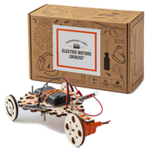
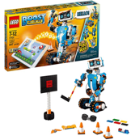
Gifts for the GRANDKIDS
Personal Planetarium – Place a smartphone into the headset and journey to the stars, Uncommon Goods $50
Anki Cozmo - a fun educational real-life toy robot. Amazon $400
LEGO Boost Creative Toolbox 17101 Fun Robot Building Set & Educational Coding Kid for Kids, Award-winning STEM Learning toy (847 pieces) Amazon $160
Tinkering Labs Electric Motors Catalyst – robotics stem kit (ages 8-12), Amazon $60

Slide 16

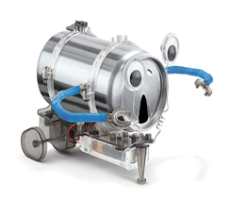

Gifts for the GRANDKIDS
LEGO Technic Cherry Picker - Lego toys (especially Technic series) are great learning tools for kids of all ages. Amazon $30
Computer Coding Book - A gift for a grandchild who has access to a computer, loves to work on it and has a parent who knows the basics to help the kid through the guide - great project for parent and kid. [Ages 10-13] $15.78
4M Tin Can Robot - create a silly robot or a motorized monster, or a combination of the two. Ages 9-12. Amazon $10

Slide 17
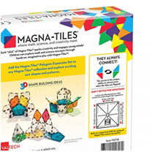
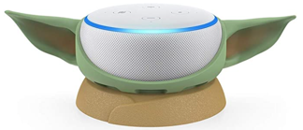

Gifts for the GRANDKIDS
Magna Tiles – 3D magnetic building sets, 8 piece polygon expansion set, Amazon $20
Echo Dot 3rd Generation, Amazon $25
FUN USB drives – 8 GB/pack of 5 Leizhan, Pro tip: search for fun usb drive, there are lots to choose from Amazon $22

Slide 18
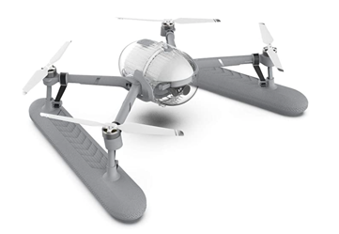
Gifts where money NO OBJECT
`
POWER EGG X WIZARD DRONE – water, weatherproof, can land on water, amazing range, great camera, $1,200

Slide 19
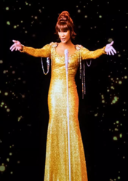

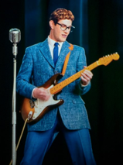
Gifts where money NO OBJECT
`
Custom Hologram – lifelike personalized 3D experience, Kanye West ”gave her father” to Kim Kardashian. Concert revivals of dead superstars like Whitney Houston, Buddy Holly, Michael Jackson. Listen intimately to Holocaust survivors in Skokie Museum. Arena3D-Industrial Illusions
Starting at $15,000 and goes up to $250,000+.

Slide 20
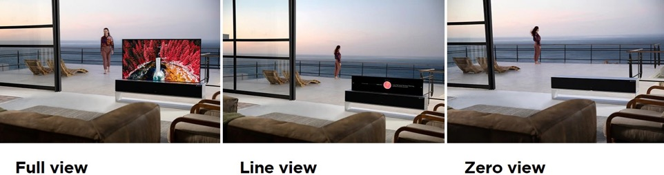
Gifts where money NO OBJECT
`
LG Signature 65 inch - LG's innovative design lets your TV appear when you need it, and disappear when you don’t. And the three different viewing choices let you maximize the stylish design as a part of your interior. Use Full View to enjoy movies, Line View for music, or Zero View to keep the TV nicely hidden. LG OLED TV is unique thanks to its self-lit technology. Over100 million self-lit sub-pixels* come together to deliver the next level of TV. Enjoy the deepest blacks, richest colors, and most realistic picture quality. Starting price $60,000.

Slide 21
`
COPIES OF GIFT GUIDE WILL BE AVAILABLE ON FACEBOOK

